Slide 1

Portfolio Analysis Quest
Gonçalo Carvalho
David Arques
May 2024

Slide 2
Project Overview 🗒️
Context: In this project, we are given a portfolio of 5 assets and we intend to apply our Python knowledge to complete 3 portfolio assessment tasks.
Tasks:
Visualize portfolio’s assets with a time series graph.
Calculate Asset’s daily percentage returns
Compute correlation matrix
Compare 2 assets with a scatter plot
Analyze the portfolio's weights (%) characteristics:
Visualize weights in an area map chart
Calculate annual return and volatility.
Group and visualize portfolio by asset type

Slide 3
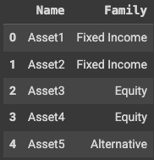
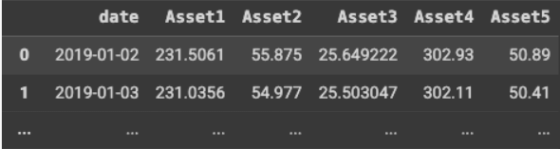
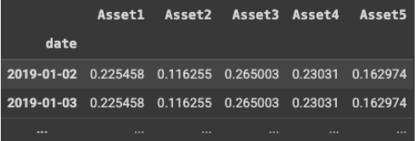
Data Sources 💾
Asset types
Asset’s daily prices
Portfolio weights (%)

Slide 4
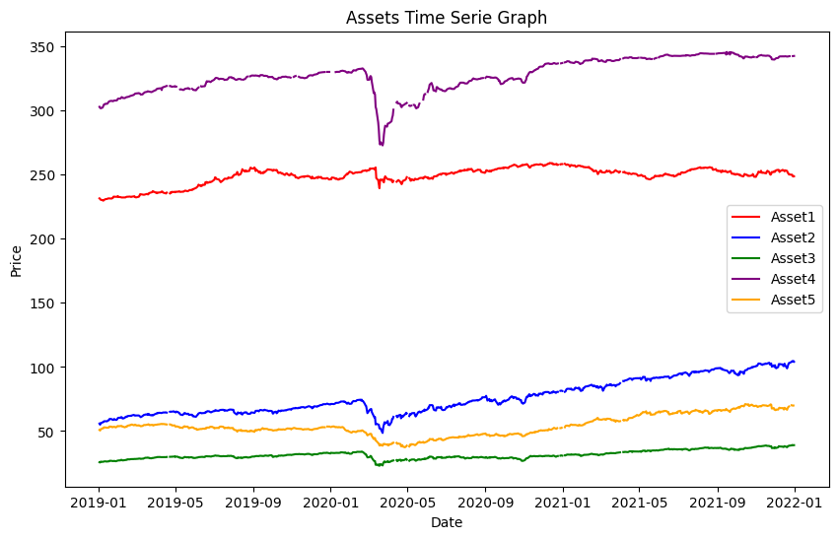
Exercise 1: Price Charting 📈
* Visualize Asset's price over time in a time series graph

Slide 5
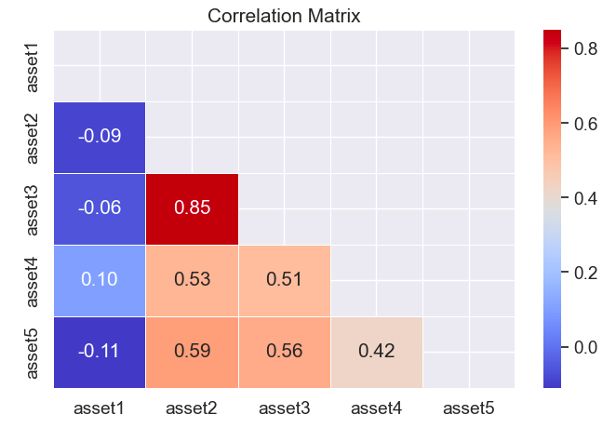
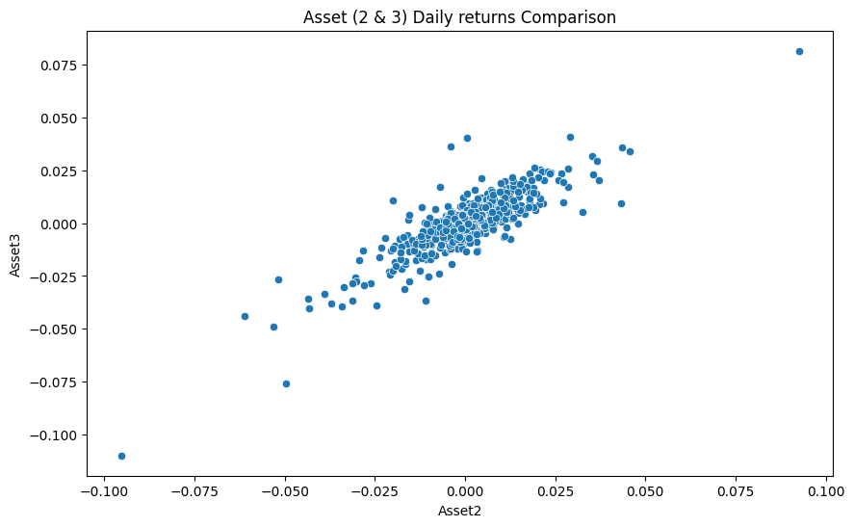
Exercise 2: Daily Percentage Returns 💰
Correlation Matrix heatmap
with Asset’s daily returns
Scatter Plot comparing
Asset 2 (Fixed Income) vs. Asset 3 (Equity)

Slide 6
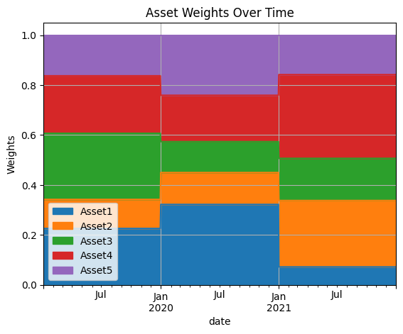
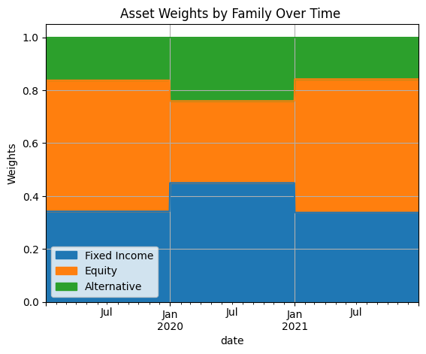
Exercise 3: Portfolio Analysis 📊
Asset's Weights (%) distribution through Area Charts
Asset’s weights
Family type

Slide 7
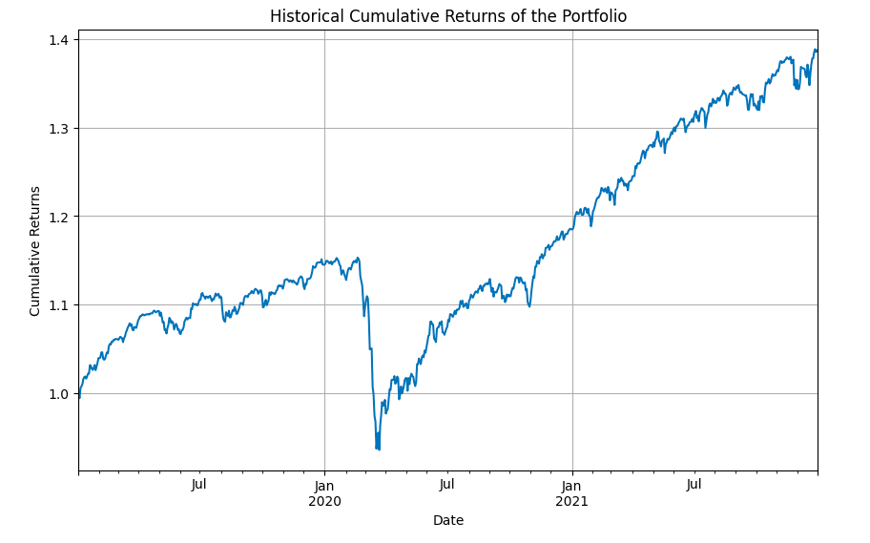
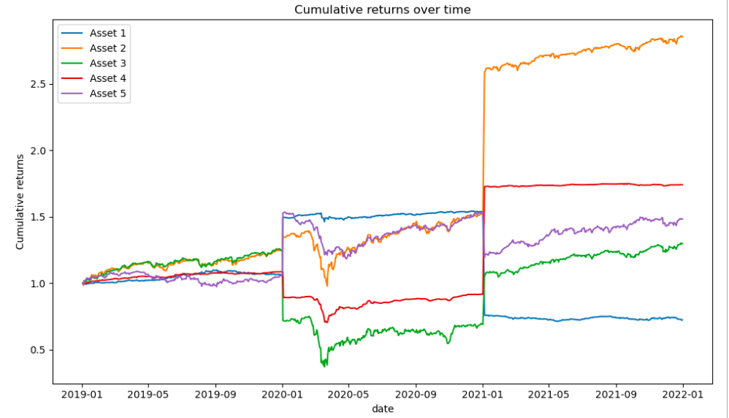
Exercise 3: Portfolio Analysis 📊
Cumulative Returns through Time
Portfolio Cumulative Returns
Cumulative Returns per Assets

Slide 8
Exercise 3: Portfolio Analysis 📊
Annualized Return
Annualized return is a measure on how much an investment increased on average each year during a specific period of time
Portfolio's annual return: 0.11
Annualized Volatility
Annualized volatility is a measure of the dispersion of returns of an investment over a specific period of time
Portfolio's annualized volatility: 0.09

Slide 9
Conclusions 💡
Exercise 1:
The 5 assets have a similar behaviour across time
We observe a significant drop in all assets from Jan to May 2020 (potentially covid-19 effect)
Exercise 2:
We can see that the highest asset correlation is Asset 2 & Asset 3 (0.85)
Lowest correlation in Asset 1 & Asset 3 with (-0.06)
We confirmed a linear correlation between Asset 2 (Fixed income) & Asset 3 (Equity) through scatter plot
Exercise 3:
In the area charts by asset family type we can see that ‘Fixed income’ & ‘Alternative’ have a similar behaviour over time compared to ‘Equity’
Portfolio’s cumulative return look profitable despite having a drop during 2020
Portfolio's annual return: 0.11 with 0.09 volatility

Slide 10
Difficulties 💥
Lack of external asset information (country, type of equity, etc.)
Understanding the financial technical concepts (cumulative returns, volatility, etc.)
Interpret the plots, specially the portfolio cumulative returns

